Slide 1
Optimal Number of Splits
Data Analytics & Machine Learning Algorithms
Overfitting, Tree Size, Pruning, Cross Validation
M. Daneshmand
MD-MIS 637-Fall 2020

Slide 2
Optimal Number of Splits
  Splitting:
    test all possible independent variables at all their possible split points,
    compute resulting gains in purity for each variable and each of its possible splitting
    points,
    pick the split ( the variable and its splitting point) that maximizes the gain and form
    the resulting cluster,
    do this over and over again on each resulting cluster (recursively) until the decision
    tree is built.
MD-MIS 637-Fall 2020

Slide 3
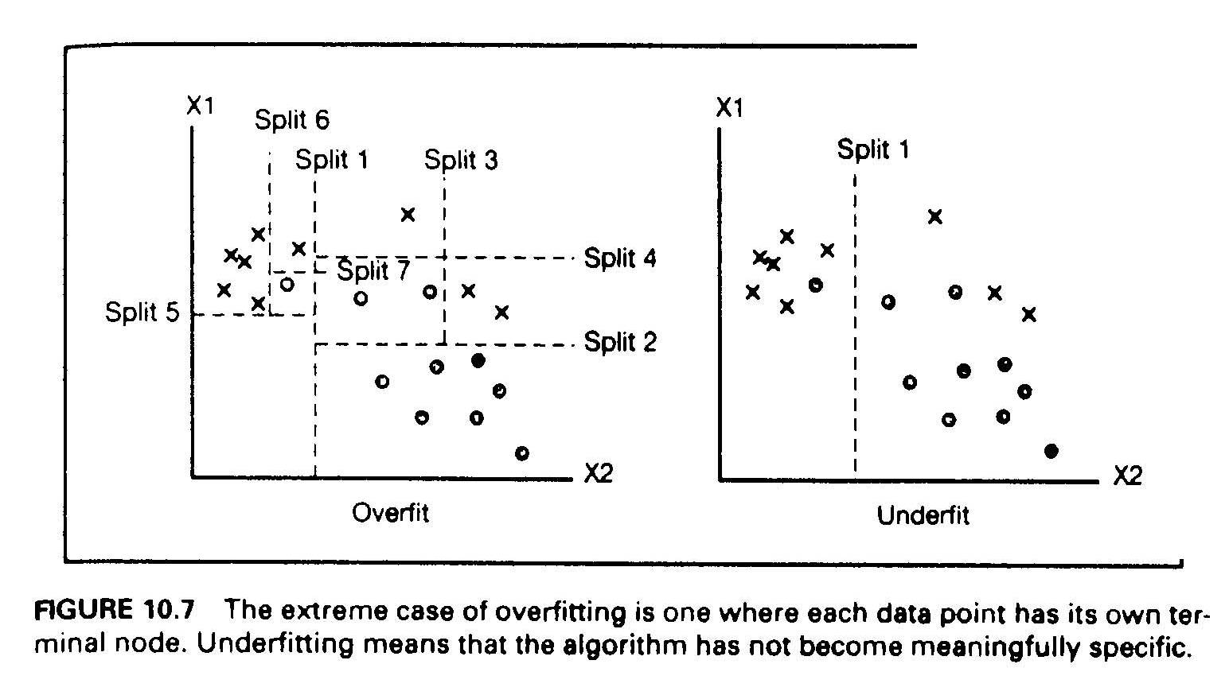
Optimal Number of Splits
  Overfitting :
    how much splitting is appropriate?
    figure below shows two extremes: “One split” (underfit) VS “Seven splits” (overfit):
    “One split” results two sub-samples (clusters) that are still quite impure (underfit),
    “Seven splits” results completely purified clusters, but the model has become very
    complicated,
    very complicated models are hard to understand and have the danger of overfitting the
    data.
MD-MIS 637-Fall 2020

Slide 4
Optimal Number of Splits
Overfitting:
    overfitting means that the algorithm finds model that fits the “training data”
    ( or the “sample”) and performs well on the trained data, but performs poorly on real
    world new data it has not seen before (out of “sample” data),
    the ML algorithm may pick up details in the data that are characteristics of the
    training sample, but not the actual problem being modeled,
    the neural nets and ML algorithms easily “overtrain”: perform well on the training
    data but badly on real world data they have not seen before.
  Cross - Validation:
    to avoid ovefitting one approach adopted by statisticians is “cross-validation”,
    in cross-validation the training data is divided into several parts, say 10,
    all parts but one is used to train the model, and use the leftover part to test the model,
    this is done several times each time using different training parts and leftover testing
    part,
    in effect splits are tested on several different combinations of training and testing data,
    for instance, with 10 parts there is a total 10 combinations of training and testing ( 9
    parts for training and 1 part for testing) .
MD-MIS 637-Fall 2020

Slide 5
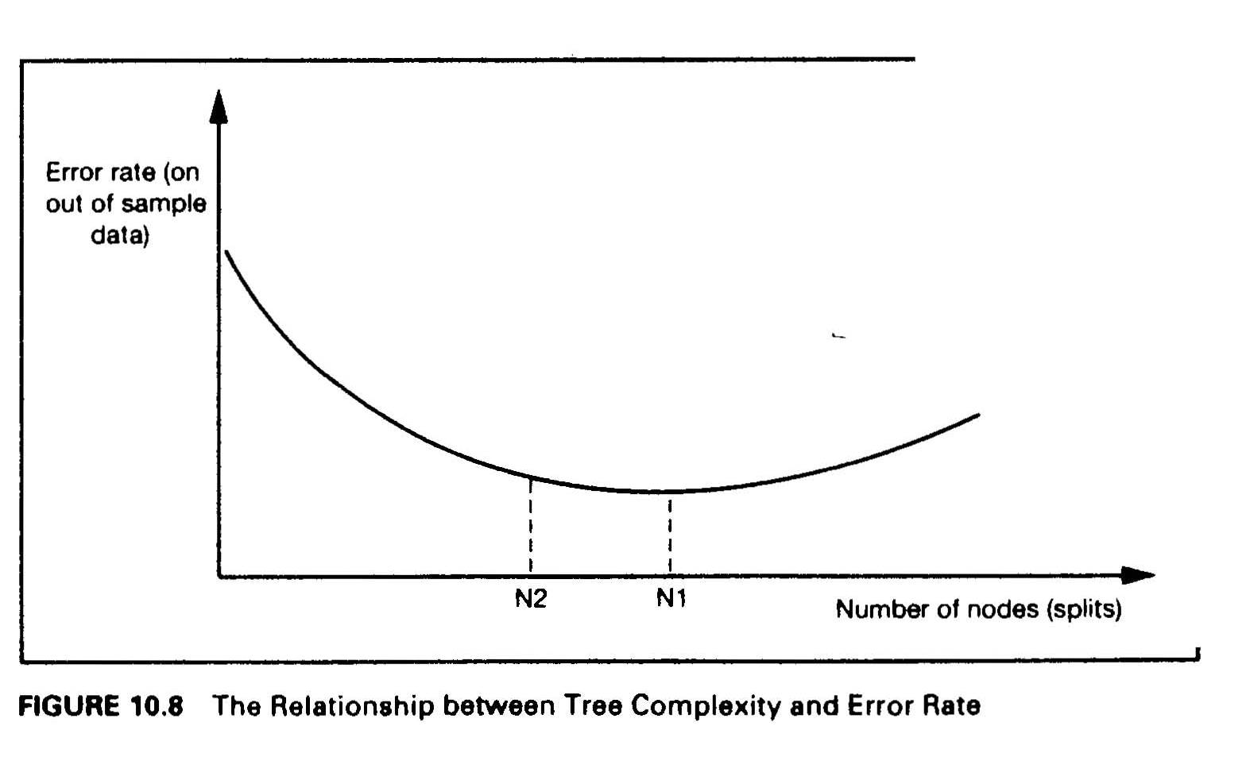
Optimal Number of Splits
  Tree Size - Optimal number of splits:
    the accuracy of the model on “out of sample” data depends on the tree size (number of
    splits),
    the error rate of the model initially decreases as the size of the the tree increases, but
    after some optimal point the error rate stars to increase (overfit),
    the accuracy is low for both very simple and very complex trees
MD-MIS 637-Fall 2020

Slide 6
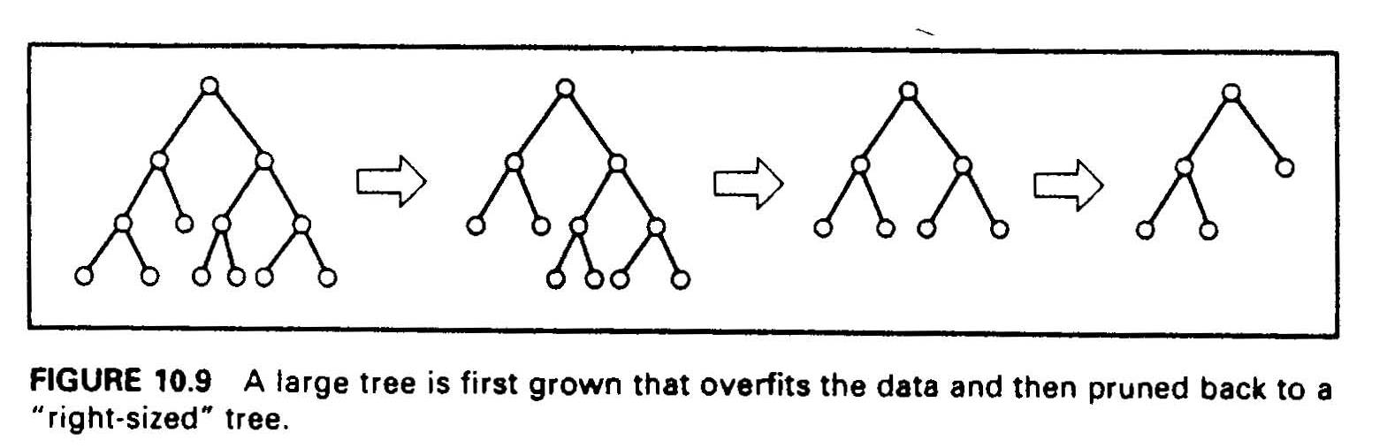
Optimal Number of Splits
  Pruning: there are two approaches to get to “right sized” trees: “Stopping” and “Pruning”
  in the stopping approach the ML algorithm must decide when to stop while going forward
  constructing the tree - it turns out that this approach is very hard,
  in the pruning approach the ML algorithm tests all possible splits and grows the complete
  (overfitted) tree, and then “prunes back” the useless branches - the ones that increase the
  error rate on “out of sample” data,
  the tree is iteratively pruned, and with each prune, the error of the pruned tree is
  computed, util the best overall tree is constructed,
  research shows that pruning approach results in much more robust trees.
MD-MIS 637-Fall 2020

Slide 7
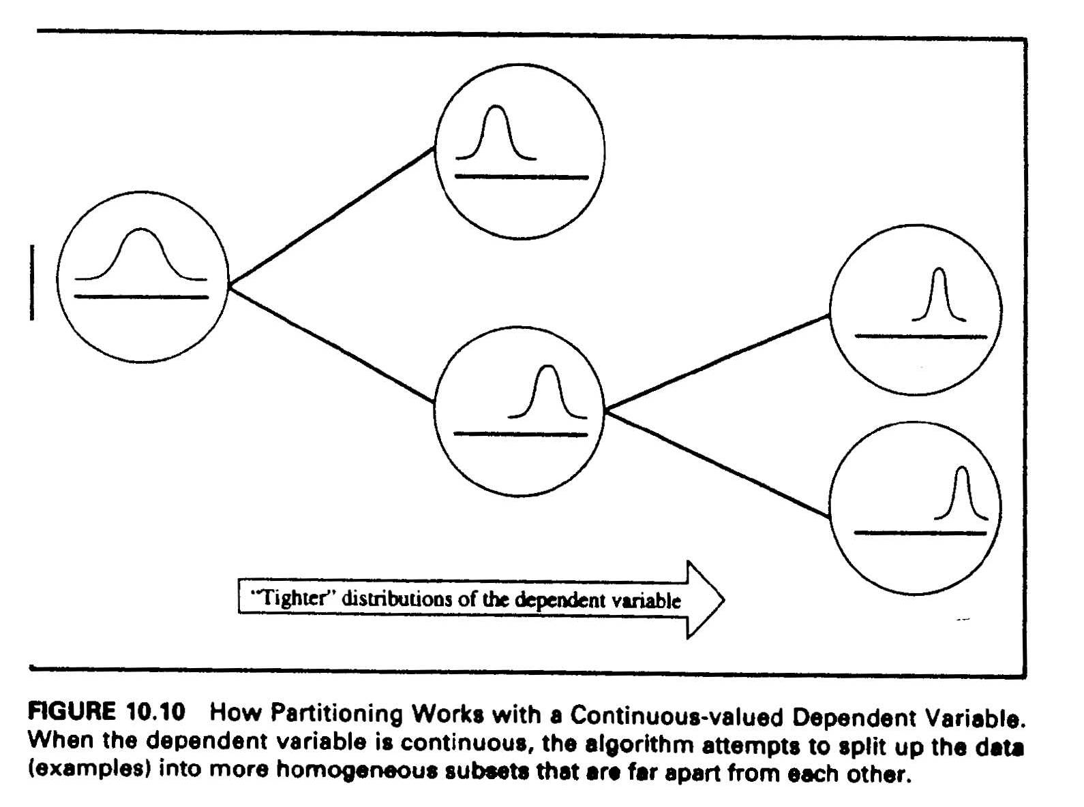
Optimal Number of Splits
Classification And Regression Trees (CART)
  if the dependent variable is continuous, CART algorithm is used to construct decision trees,
  for continuous variables there is no notion of “pure” partition - there are infinite values for
  a dependent variable, classification and clustering is done through the notion of “dispersion”,
  disorder is measured by variance ( a measure of “dispersion” around the “ center ”),
  homogeneous clusters are formed from items that their dependent variable values are all
  close to each other - i.e., their standard deviation would be quite small,
  the criteria is to form clusters with minimum “ within cluster ” variance and maximum
  “between clusters” means - impurity and gain are measured by the pair (mean, SD)
MD-MIS 637-Fall 2020

Slide 8
Optimal Number of Splits
CART: Example
    Problem: a software company that sells packaged PC software wants to derive decision rules that determine type of customers generating highest revenue,
    Data: the company has a database containing records of approximately 2000 customers - each record consists of values of 31 variables,
    Dependent Variable(s): “total annual sales” made to the customer ( a continuous variable),
    Independent Variables: there were 30 independent variables recorded for each customer.
    Solution:
    _ since the dependent variable (sales) is continuous a CART Algorithm has been used,
    clusters were formed by computing mean and standard deviation of customers total
    annual sales,
    homogenous clusters were identified based on minimum ‘within cluster SD” and
    maximum between clusters means,
    the partitioning algorithm found only three of the 30 independent variables to be
    relevant for classifying customers:
      the number of users in the customer’s organization,
      the number of inquiries they made about the product they purchased,
      and the number of product licenses they purchased,
    figure below shows the tree that was constructed using actual data and the CART Algorithm.
MD-MIS 637-Fall 2020

Slide 9
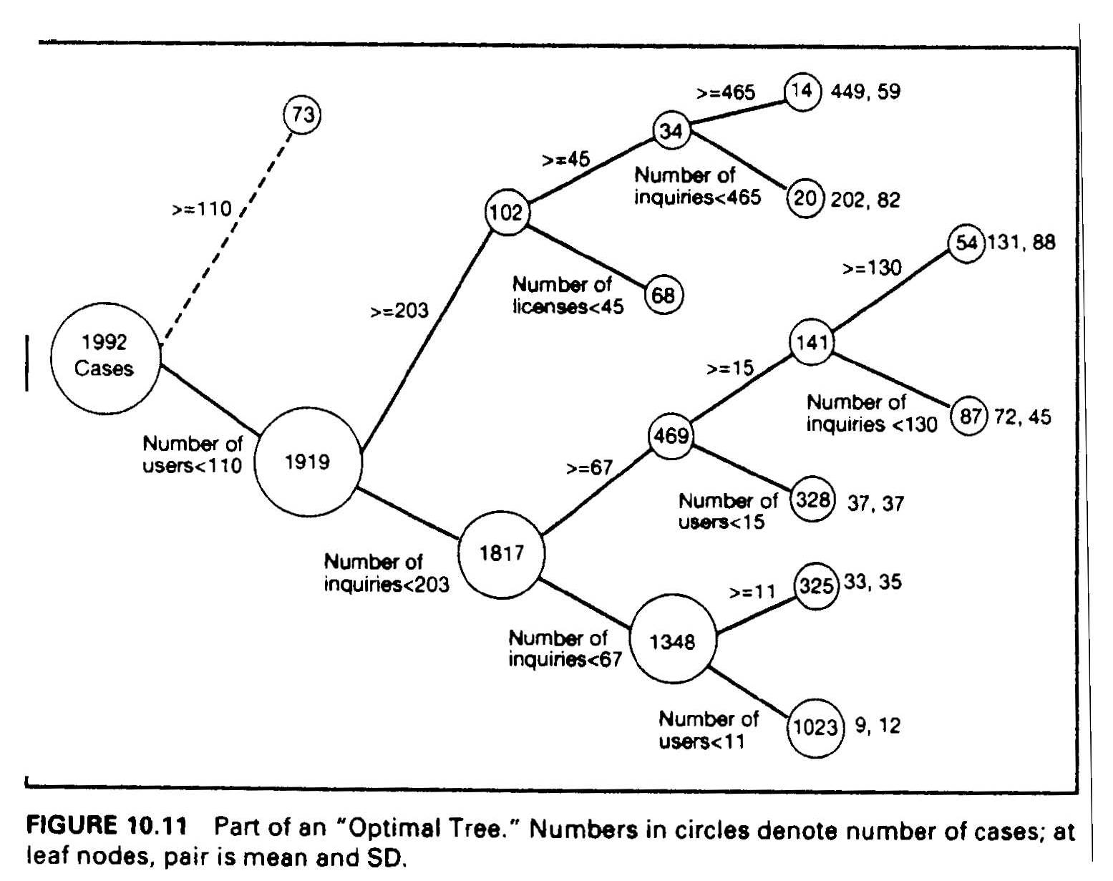
Optimal Number of Splits
CART
      it is hard to interpret the tree,
      the top branch has not been expanded.
MD-MIS 637-Fall 2020

Slide 10
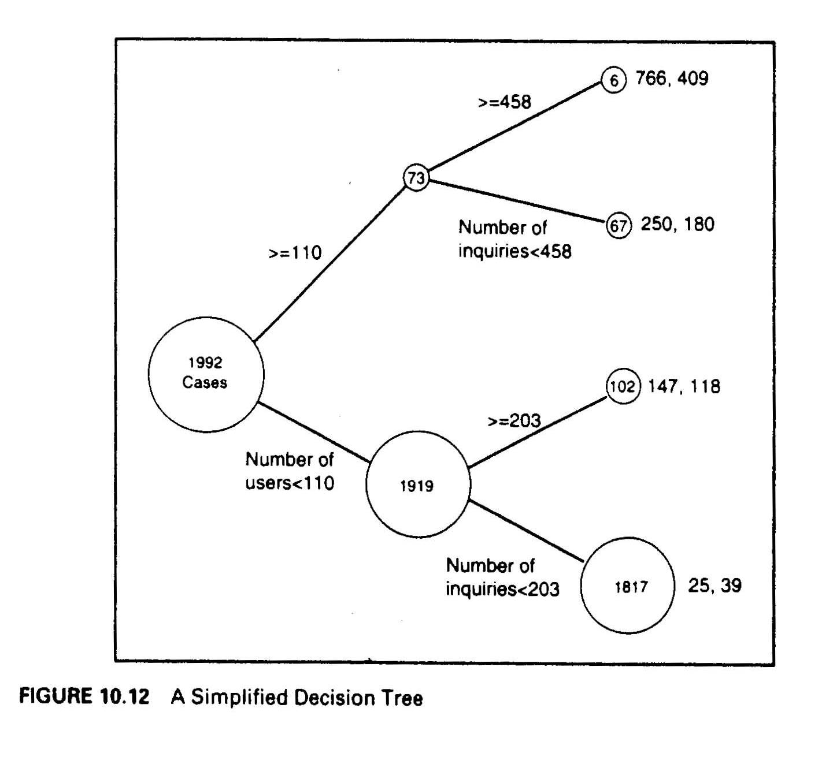
Optimal Number of Splits
CART:
  The simplified tree is easier to interpret, it splits the data into four types that can be classified into a 2 by 2 matrix:
    large customers who make large number of inquiries,
    large customers who make a few number of inquiries,
    small customers who make large number of inquiries,
    small customers who make small number of inquiries.
MD-MIS 637-Fall 2020

